Slide 1
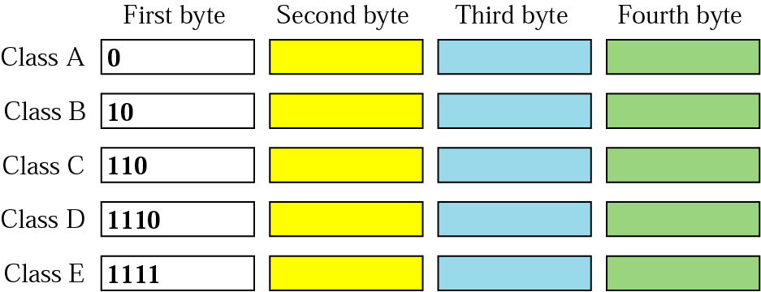
Figure 19.10 Finding the class in binary notation

Slide 2
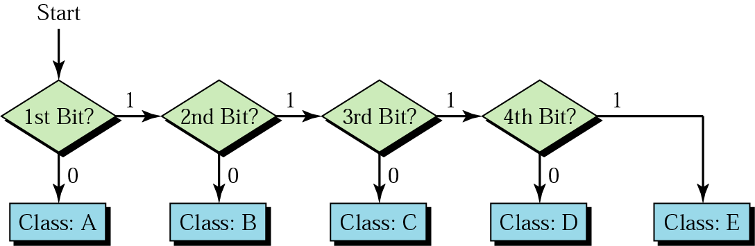
Figure 19.11 Finding the address class

Slide 3
Example 3
Find the class of each address:
a. 00000001 00001011 00001011 11101111
b. 11110011 10011011 11111011 00001111
Solution
See the procedure in Figure 19.11.
a. The first bit is 0; this is a class A address.
b. The first 4 bits are 1s; this is a class E address.

Slide 4
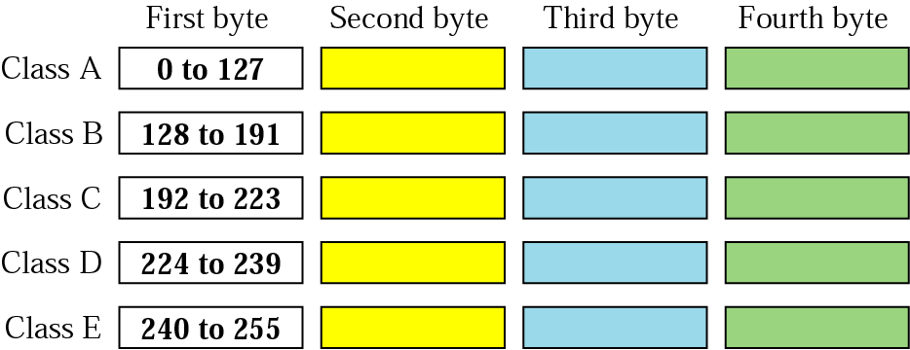
Figure 19.12 Finding the class in decimal notation
Class A 00000000 - 011111111
127
Class B 10000000 - 101111111
191
…
Class E 11110000 - 11111111

Slide 5
Example 4
Find the class of each address:
a. 227.12.14.87
b. 252.5.15.111
c. 134.11.78.56
Solution
a. The first byte is 227 (between 224 and 239); the class is D.
b. The first byte is 252 (between 240 and 255); the class is E.
c. The first byte is 134 (between 128 and 191); the class is B.

Slide 6
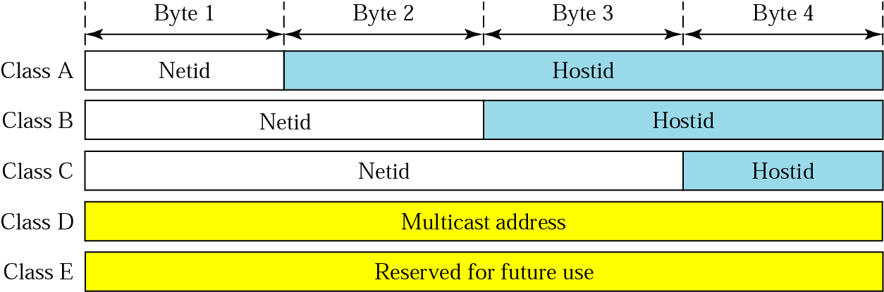
Figure 19.13 Netid and hostid

Slide 7
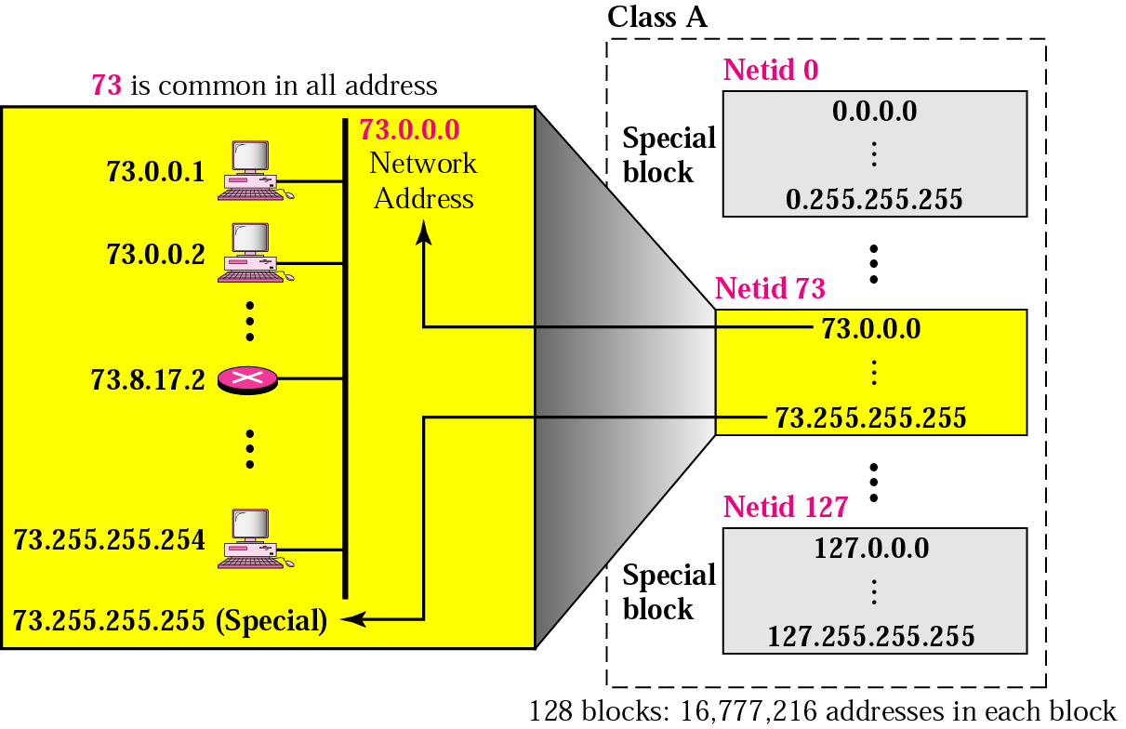
Figure 19.14 Blocks in class A
First byte
Class A 00000000 - 011111111
Distinct 7 bits network id = 2⁷ network blocks = 128 blocks
Distinct 24 bits host id = 2²⁴ host addresses

Slide 8
Note:
Millions of class A addresses are wasted.

Slide 9
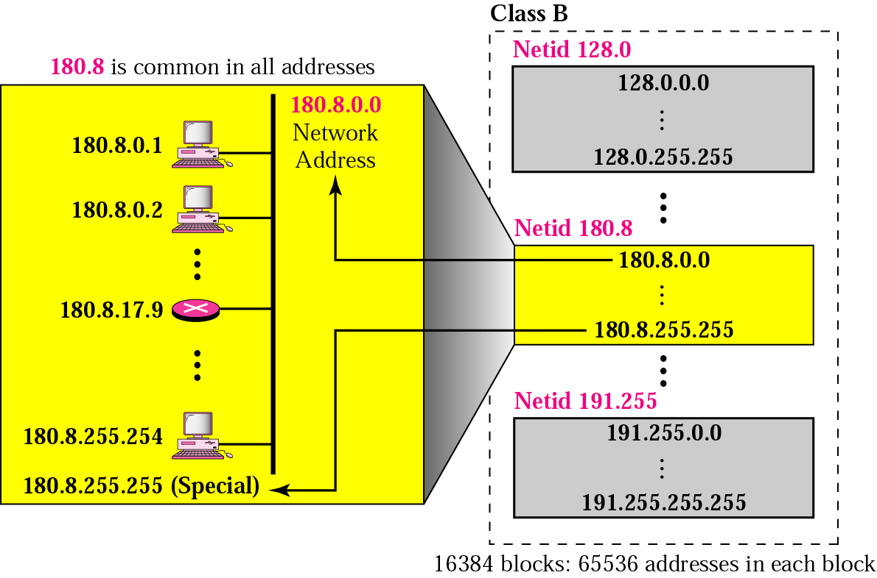
Figure 19.15 Blocks in class B
First byte
Second byte
Class B 10000000 - 101111111
Distinct 14 bits network id = 2¹⁴ network blocks = 16384 blocks
Distinct 16 bits host id = 2¹⁶ host addresses

Slide 10
Note:
Many class B addresses are wasted.

Slide 11
Note:
The number of addresses in class C is smaller than the needs of most organizations.

Slide 12
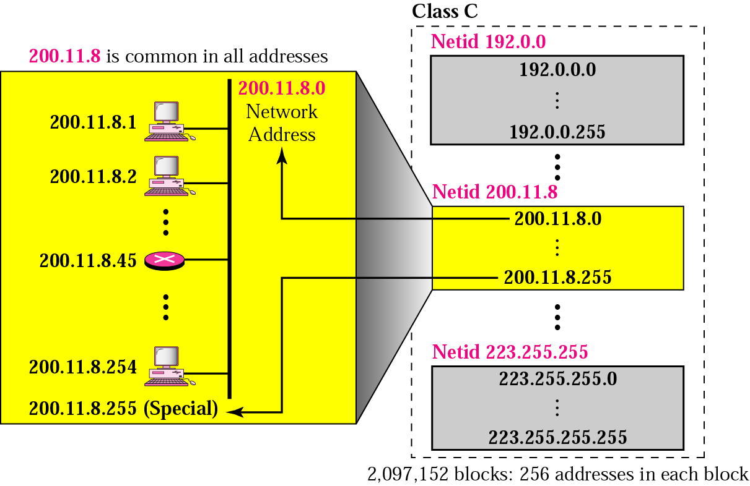
Figure 19.16 Blocks in class C
First byte
Second byte
Third byte
Class B 11000000 - 110111111
Distinct 21 bits network id = 2²¹ network blocks = 2097152 blocks
Distinct 8 bits host id = 2⁸ host addresses

Slide 13
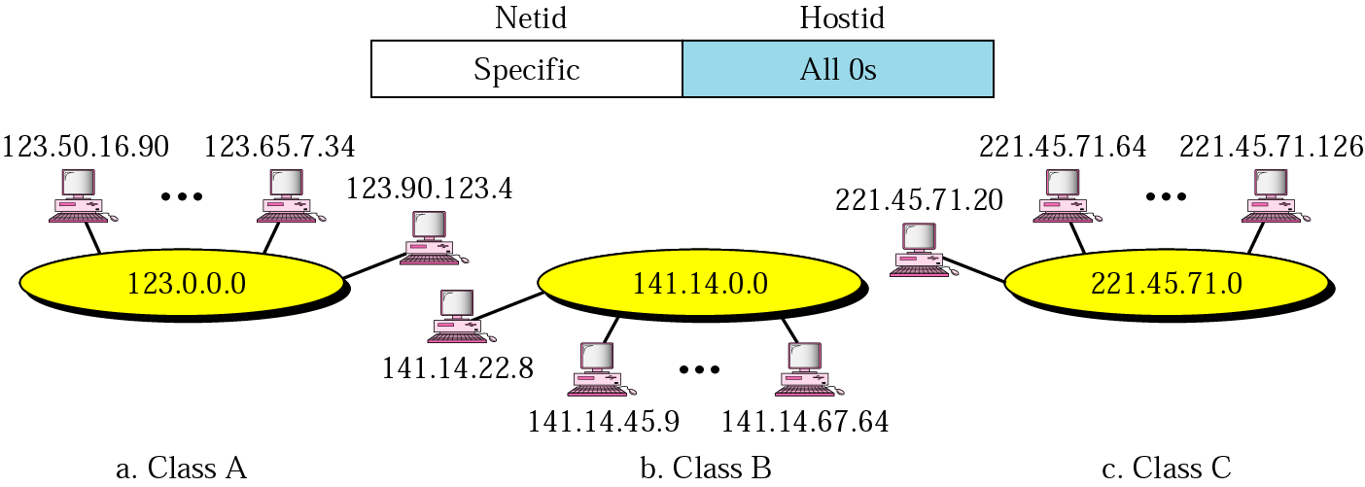
Figure 19.17 Network address

Slide 14
Note:
In classful addressing, the network address is the one that is assigned to the organization.

Slide 15
Example 5
Given the address 23.56.7.91, find the network address.
Solution
The class is A. Only the first byte defines the netid. We can find the network address by replacing the hostid bytes (56.7.91) with 0s. Therefore, the network address is 23.0.0.0.

Slide 16
Example 6
Given the address 132.6.17.85, find the network address.
Solution
The class is B. The first 2 bytes defines the netid. We can find the network address by replacing the hostid bytes (17.85) with 0s. Therefore, the network address is 132.6.0.0.

Slide 17
Example 7
Given the network address 17.0.0.0, find the class.
Solution
The class is A because the netid is only 1 byte.

Slide 18
Note:
A network address is different from a netid. A network address has both netid and hostid,
with 0s for the hostid.

Slide 19
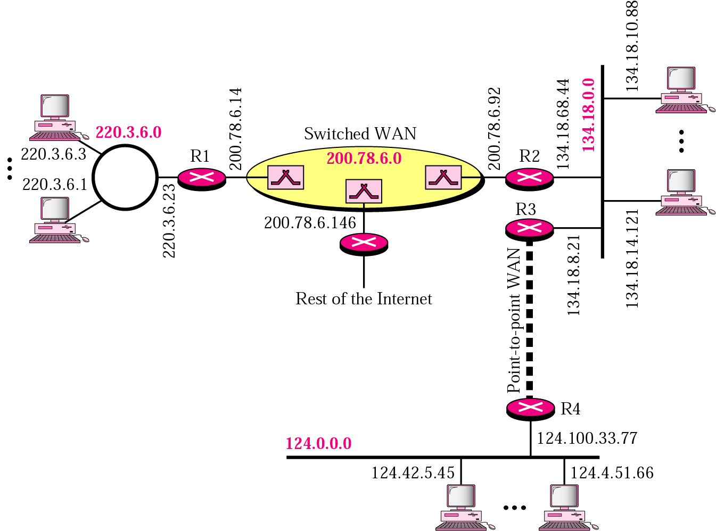
Figure 19.18 Sample internet
4 network addresses

Slide 20
Note:
IP addresses are designed with two levels of hierarchy.

Slide 21
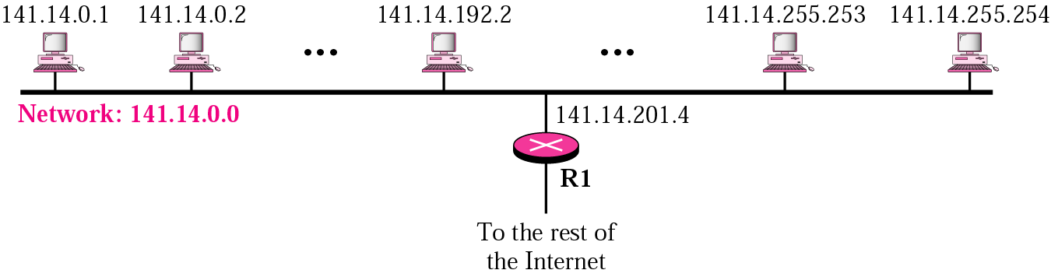
Figure 19.19 A network with two levels of hierarchy
Network
(network id)
Host

Slide 22
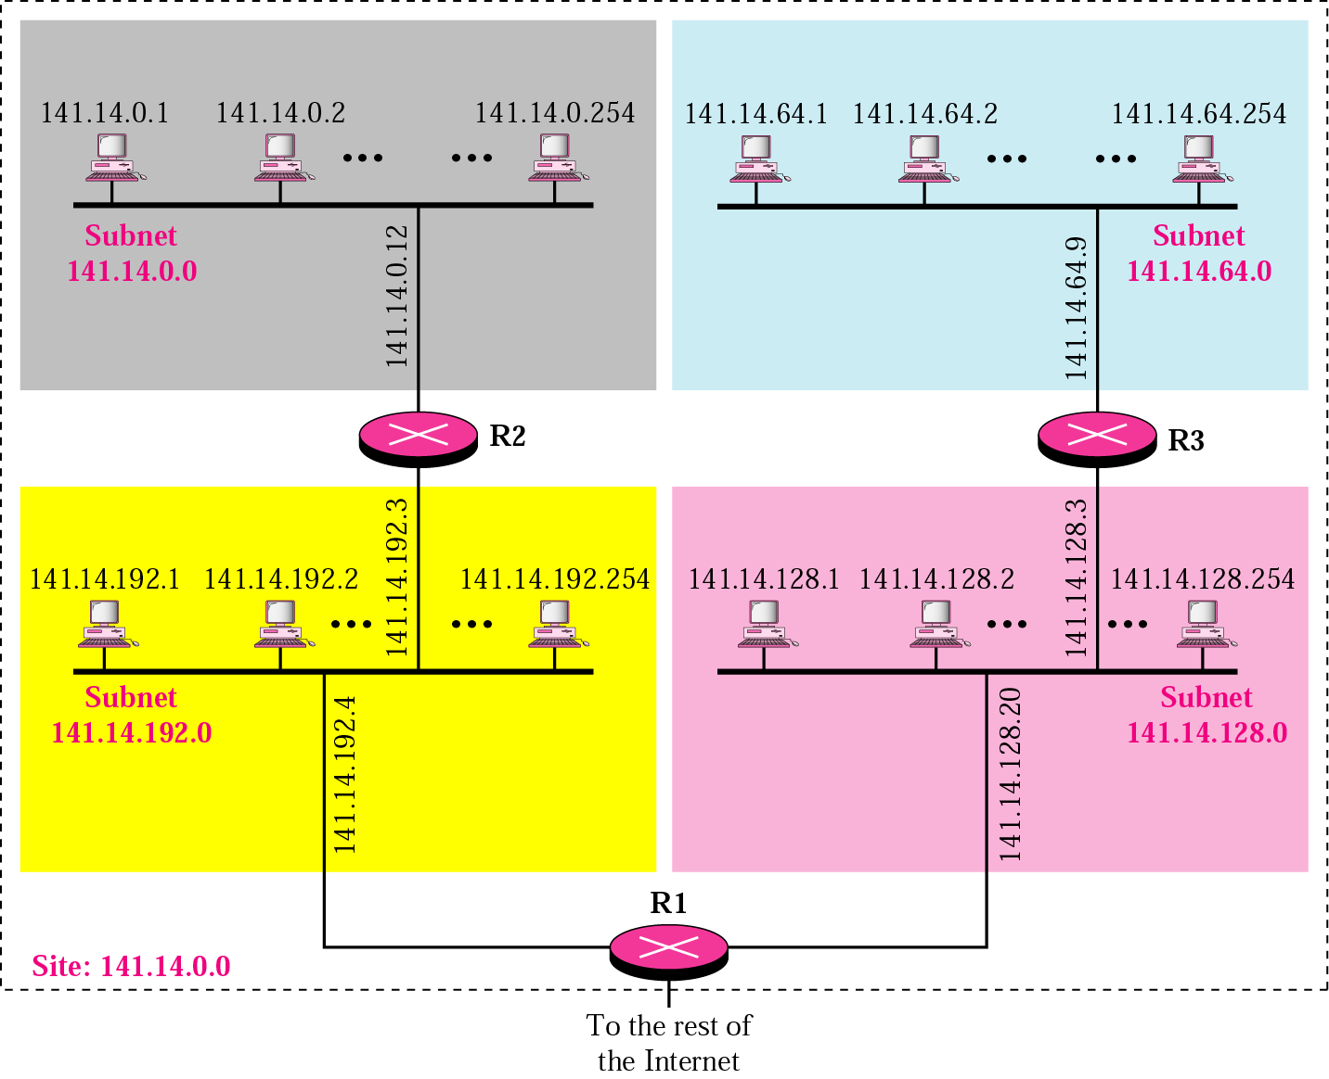
Figure 19.20 A network with three levels of hierarchy (subnetted)
network

Slide 23
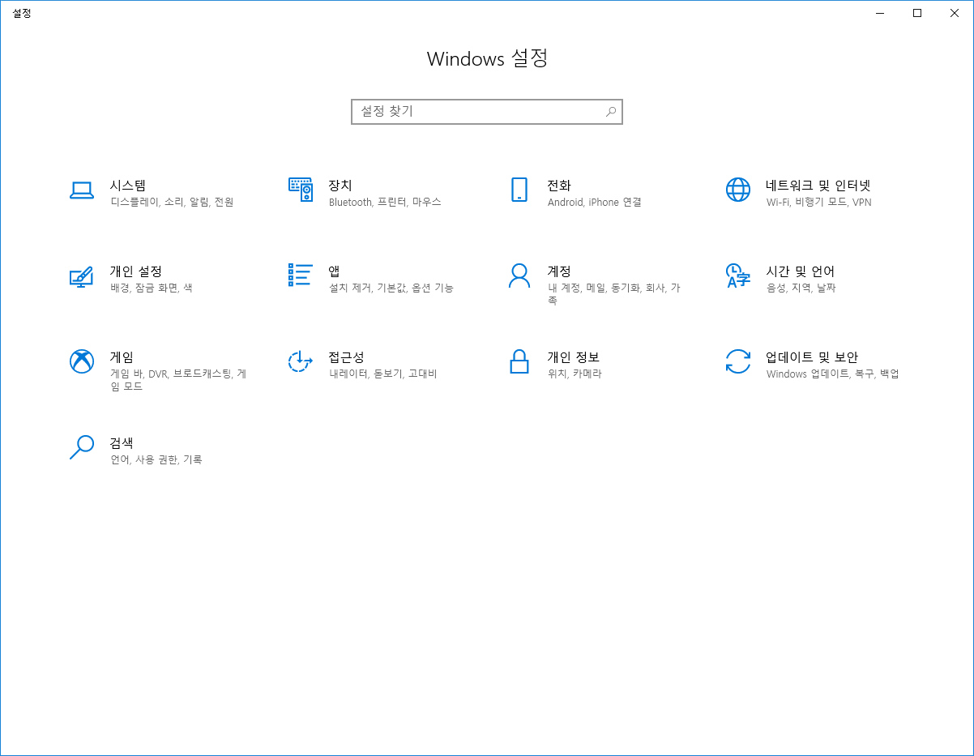
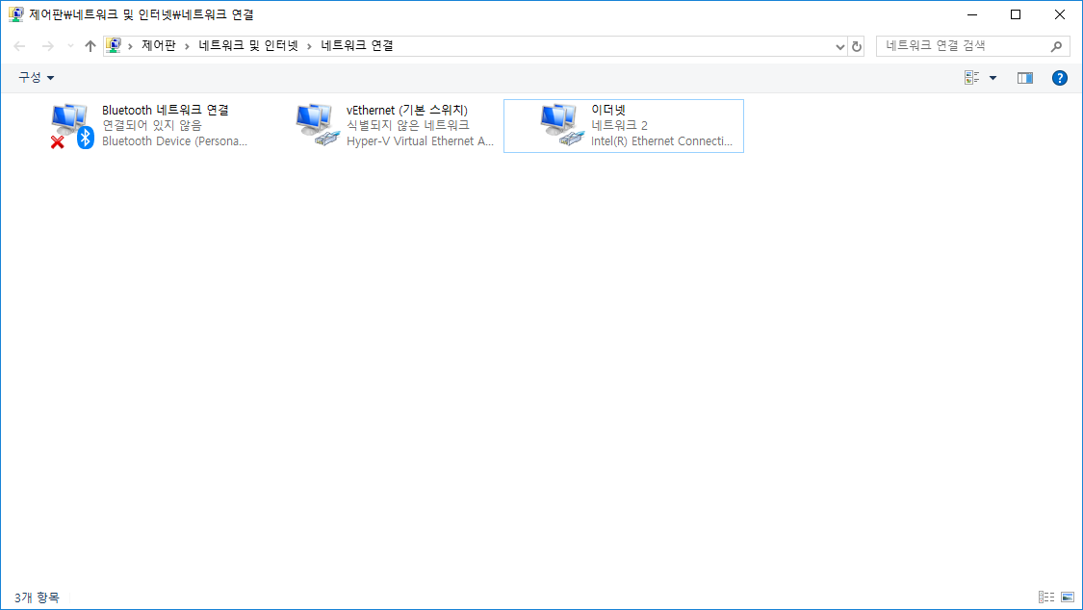
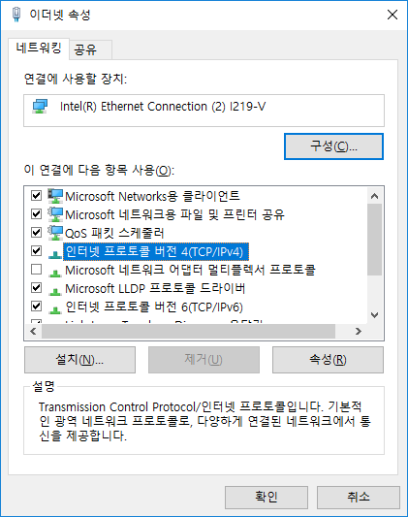
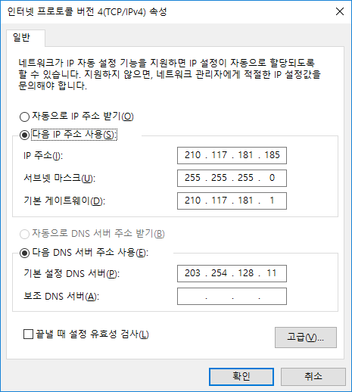
11010010
01110101
10110101
10111001
11111111
11111111
11111111
00000000
&
11010010
01110101
10110101
00000000
210.117.181.0
Network Address!!

Slide 24
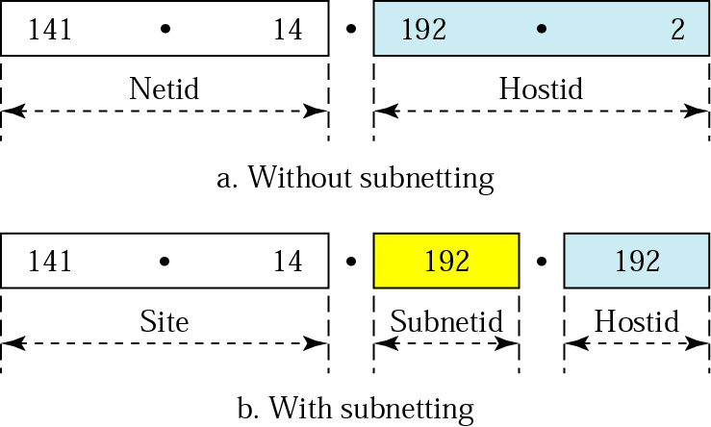
Figure 19.21 Addresses in a network with and without subnetting

Slide 25
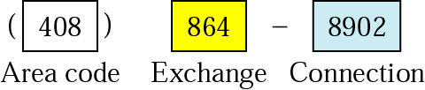
Figure 19.22 Hierarchy concept in a telephone number

Slide 26
MASK for obtaining network and subnetwork address
Table 19.1 Default masks
Class | In Binary | In Dotted-Decimal | Using Slash
A | 11111111 00000000 00000000 00000000 | 255.0.0.0 | /8
B | 11111111 11111111 00000000 00000000 | 255.255.0.0 | /16
C | 11111111 111111111 11111111 00000000 | 255.255.255.0 | /24

Slide 27
Note:
The network address can be found
by applying the default mask to any
address in the block (including itself).
It retains the netid of the block and sets the hostid to 0s.

Slide 28
Example 8
A router outside the organization receives a packet with destination address 190.240.7.91. Show how it finds the network address to route the packet.
Solution
The router follows three steps:
The router looks at the first byte of the address to find the class. It is class B.
The default mask for class B is 255.255.0.0. The router ANDs this mask with the address to get 190.240.0.0.
The router looks in its routing table to find out how to route the packet to this destination. Later, we will see what happens if this destination does not exist.

Slide 29
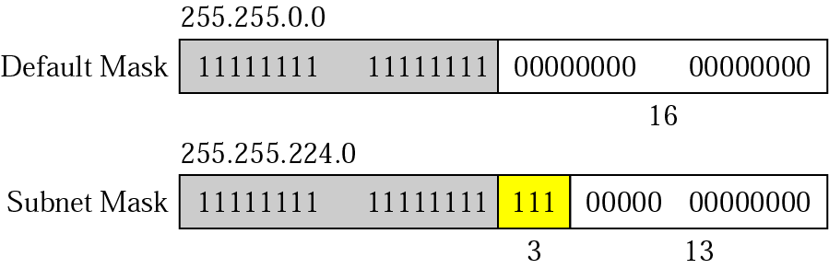
Figure 19.23 Subnet mask

Slide 30
Example 9
A router inside the organization receives the same packet with destination address 190.240.33.91. Show how it finds the subnetwork address to route the packet.
1011 1110
1111 0000
0010 0001
0101 1011
1111 1111
1111 1111
1110 0000
0000 0000
&
Solution
11010010
01110101
0010 0000
00000000
190.240.32.0
Network Address!!
The router follows three steps:
The router must know the mask. We assume it is /19, as shown in Figure 19.23.
The router applies the mask to the address, 190.240.33.91. The subnet address is 190.240.32.0.
The router looks in its routing table to find how to route the packet to this destination. Later, we will see what happens if this destination does not exist.

Slide 31
Need for Dynamic Address Configuration
Each computer attached to the Internet must have the following information:
  Its IP address
  Its subnetwork mask
  The IP address of a router
  The IP address of a name server
How could you obtain its IP address when moved to other unknown network?
  Dynamic Host Configuration Protocol (DHCP)

Slide 32
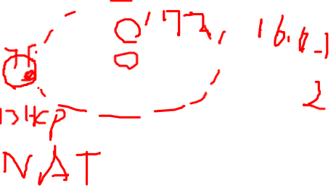
Which IP addresses for DHCP?
Usually private addresses
Table 19.2 Addresses for private networks
Range | Total
10.0.0.0 to 10.255.255.255 | 2²⁴
172.16.0.0 to 172.31.255.255 | 2²⁰
192.168.0.0 to 192.168.255.255 | 2¹⁶
A router does not forward packets from private networks
Why we need private networks?
How could access the Internet within a private network?
NAT

Slide 33
IP addressing
Q: How does an ISP get block of addresses?
A: ICANN: Internet Corporation for Assigned
Names and Numbers
  allocates addresses
  manages DNS
  assigns domain names, resolves disputes

Slide 34
DHCP: Dynamic Host Configuration Protocol
Goal: allow host to dynamically obtain its IP address from network server when it joins network
  Can renew its lease on address in use
  Allows reuse of addresses (only hold address while connected an “on”
  Support for mobile users who want to join network (more shortly)
DHCP overview:
  host broadcasts “DHCP discover” msg
  DHCP server responds with “DHCP offer” msg
  host requests IP address: “DHCP request” msg
  DHCP server sends address: “DHCP ack” msg

Slide 35
DHCP client-server scenario
A
223.1.1.1
DHCP
223.1.2.1
server
223.1.1.2
223.1.1.4
223.1.2.9
B
223.1.2.2
E
arriving DHCP
client needs
address in this
network
223.1.1.3
223.1.3.27
223.1.3.1
223.1.3.2

Slide 36
DHCP client-server scenario
DHCP server: 223.1.2.5
arriving
client
DHCP discover
src : 0.0.0.0, 68
dest.: 255.255.255.255,67
yiaddr: 0.0.0.0
transaction ID: 654
DHCP offer
src: 223.1.2.5, 67
dest: 255.255.255.255, 68
yiaddrr: 223.1.2.4
transaction ID: 654
Lifetime: 3600 secs
DHCP request
src: 0.0.0.0, 68
dest:: 255.255.255.255, 67
yiaddrr: 223.1.2.4
transaction ID: 655
Lifetime: 3600 secs
time
DHCP ACK
src: 223.1.2.5, 67
dest: 255.255.255.255, 68
yiaddrr: 223.1.2.4
transaction ID: 655
Lifetime: 3600 secs

Slide 37
NAT: Network Address Translation
rest of
Internet
local network
(e.g., home network)
10.0.0/24
10.0.0.1
10.0.0.4
10.0.0.2
138.76.29.7
10.0.0.3
All datagrams leaving local
network have same single source NAT IP address: 138.76.29.7,
different source port numbers
Datagrams with source or
destination in this network
have 10.0.0/24 address for
source, destination (as usual)

Slide 38
NAT: Network Address Translation
Motivation: local network uses just one IP address as far as outside word is concerned:
  no need to be allocated range of addresses from ISP: - just one IP address is used for all devices
  can change addresses of devices in local network without notifying outside world
  can change ISP without changing addresses of devices in local network
  devices inside local net not explicitly addressable, visible by outside world (a security plus).

Slide 39
NAT: Network Address Translation
NAT translation table
WAN side addr LAN side addr
1: host 10.0.0.1
sends datagram to
128.119.40, 80
2: NAT router
changes datagram
source addr from
10.0.0.1, 3345 to
138.76.29.7, 5001,
updates table
138.76.29.7, 5001 10.0.0.1, 3345
…… ……
S: 10.0.0.1, 3345
D: 128.119.40.186, 80
10.0.0.1
1
2
S: 138.76.29.7, 5001
D: 128.119.40.186, 80
10.0.0.4
10.0.0.2
138.76.29.7
S: 128.119.40.186, 80
D: 10.0.0.1, 3345
4
S: 128.119.40.186, 80
D: 138.76.29.7, 5001
3
10.0.0.3
4: NAT router
changes datagram
dest addr from
138.76.29.7, 5001 to 10.0.0.1, 3345
3: Reply arrives
dest. address:
138.76.29.7, 5001

Slide 40
NAT: Network Address Translation
16-bit port-number field:
  60,000 simultaneous connections with a single LAN-side address!
address shortage should instead be solved by IPv6
  A computer that resides in a private network cannot be a public server

Slide 41
19.3 Routing
Routing Techniques
Static Versus Dynamic Routing
Routing Table for Classful Addressing
Routing Table for Classless Addressing

Slide 42
Routing techniques
Key
  Small routing table
  Fast table lookup
Techniques
  Next-hop routing
  Network-specific routing
  Host-specific routing
  Default routing
  Combination

Slide 43
IP datagram format
IP protocol version
number
32 bits
total datagram
length (bytes)
header length
(bytes)
head.
len
type of
service
ver
length
for
fragmentation/
reassembly
“type” of data
flgs
fragment
offset
16-bit identifier
max number
remaining hops
(decremented at
each router)
time to
live
upper
layer
Internet
checksum
32 bit source IP address
upper layer protocol
to deliver payload to
32 bit destination IP address
Options (if any)
E.g. timestamp,
record route
taken, specify
list of routers
to visit.
how much overhead with TCP?
20 bytes of TCP
20 bytes of IP
= 40 bytes + app layer overhead
data
(variable length,
typically a TCP
or UDP segment)

